Slide 1
What can IT do for you? Don’t let IT be lead astray!
Richard Rose, CPA
Chris Pembrook, MBA, CPA, CGAP, CFA

Slide 2
How many times have the auditors asked you questions…
Were they Internal Auditors or External Auditors?
Was it just fraud related?
Was it just for a simple report?

Slide 3
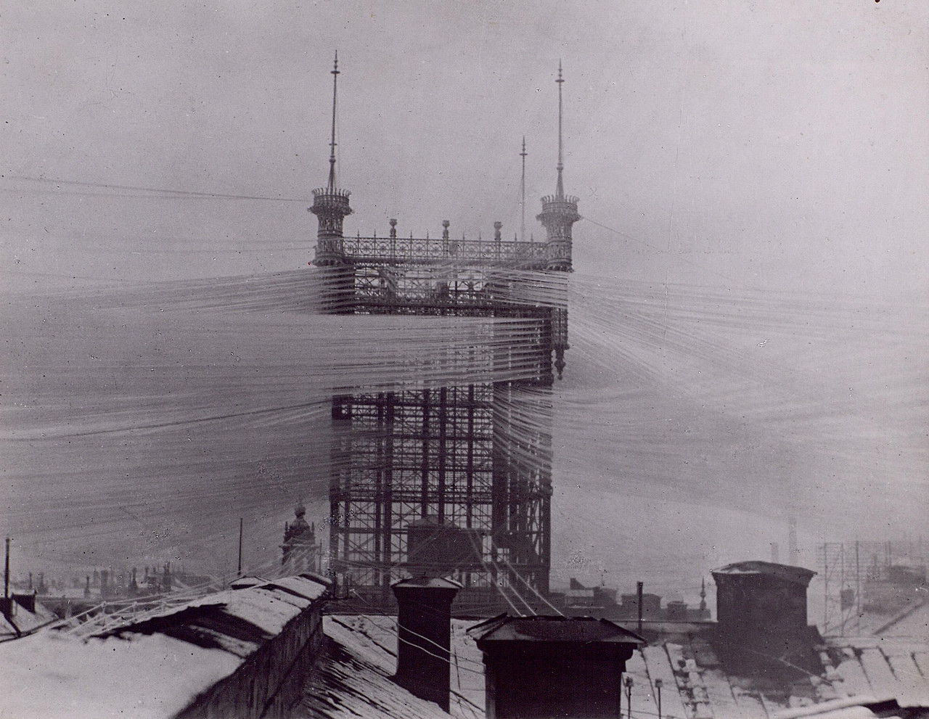
Things are about to change!
WHY
&
How

Slide 4
WHY – COSO Got Smart?

Slide 5
What is COSO?
COSO (Committee of Sponsoring Organizations) of the Treadway Commission
American Accounting Association (AAA)
American Institute of Certified Public Accountants(AICPA)
Financial Executives International (FEI)
Institute of Management Accountants (IMA)
The Institute of Internal Auditors (IIA)

Slide 6
Components of Internal Control

Slide 7
Who touches all of these?

Slide 8
HOW ???

Slide 9
What will they be asking for?
Polices in place to safe guard information
Documentation and review of customization to software
Security features in place to prevent segregation of duties issues
Detail reports with time stamps to review data in date order
Random information that they will tie to other information to see what the results are

Slide 10
Polices
Disaster recovery plan
Has it been tested
Who does what step incase communication is down
Password & Email policy
Termination policy
Mobile device policy
What does it cover? PDAs
Thumb drives
Tablets
Cell phones
Do you use Microsoft ActiveSync(EAS)?

Slide 11
Customized Software
What changes have been made to the base software?
Who reviewed the changes before they were implemented?
Is there someone on your staff cross trained to understand the changes made?
Does anyone watch or review what consultants or software support changes?
Basically who is getting the rounding digit from Office Space?

Slide 12
Segregation of Duties
Who is to blame for improper access to software?
Do you have a transfer policy?
Do you have an annual review of software and folder access that a department supervisor checks?
Who knew THAT did that?

Slide 13
Reports
Who runs custom reports for your system?
Approval report
Detail report that shows all access to an account and the detail of that account.
Access reports
Login reports

Slide 14
Random Information
Sick leave reports
How many cell phones are connected to exchange?
Who has not logged on in 6 weeks report?
Reports that will ask for a very specific item
Can you run it?
If not do you have something close
May never know why they need it?

Slide 15
Microsoft Exchange ActiveSync(EAS)
EAS protocol concepts
The protocol specification explains how devices and Exchange servers are supposed to talk to one another: which commands each can emit, which kinds of responses are legal for each command, and so on.
Exchange implements EAS on the server side. Besides the code that actually sends and receives data using EAS, there's code that allows administrators to view and set EAS policies through the Exchange Management Console (EMC) and Exchange Management Shell (EMS), code for logging, and code for controlling which devices can connect and what they can do after connecting.

Slide 16
What can EAS control on devices?
Simple things
Email, Calendar, Contact syncs
Remote wipe
Folder syncs
Useful things
Require password
Password Complexity
Encryption
Allow attachment downloads

Slide 17
EAS – At your own risk?
Full Disclosure I am not saying you should use these. Just that they are there.
Disable Camera
Allow browser
Disable Bluetooth or Wi-Fi (windows and blackberry only)
Disable POP3/IMAP4 email (windows and blackberry only)
Include past email items(Days)

Slide 18
richard@crawfordcpas.com
chris@crawfordcpas.com

